Slide 1
Our finest hours?
Walter Ricciardi
PRESIDENT
ISTITUTO SUPERIORE DI SANITÀ
ITALIAN NATIONAL INSTITUTE OF HEALTH

Slide 9
to understand and to tackle present and future challenges
we must realize that we are living in times of war

Slide 10
Over the last eight years the world has witnessed
The worst financial crisis since 1928
Global recession
An unprecedented Eurozone Sovereign Debt Crisis
Outbreak of War in the Middle East and North Africa
Civil war in Syria
A major migration crisis in Europe
War between Russia and Ukraine
Brexit
The surge of cyber-terrorism (US Elections)
Nuclear tension in North Korea
“Secession” of Catalonia
The first populist government in a founding member of EU
Trade war between USA and the world
What does this mean for health and health care?

Slide 11
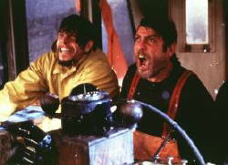
The changing health systems landscape is preparing for the “perfect storm”
A "perfect storm" is an expression that describes an event where a rare combination of circumstances will aggravate a situation drastically.
The term is also used to describe an actual phenomenon that happens to occur in such a confluence, resulting in an event of unusual magnitude.

Slide 12
The waves of
demand and supply
Demographic and epidemiological transition
Technological innovation
Health Systems
Professional differentiation
Populations needs and demand

Slide 13
Demand
DEMOGRAPHY: By 2050 over 1/3 of EU population will be over 60 years old (UN)
% of EU population aged +60
1950
2050
Million

Slide 14
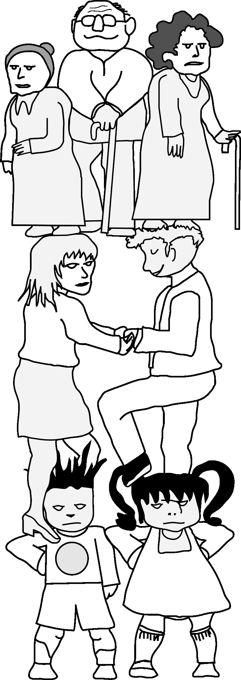
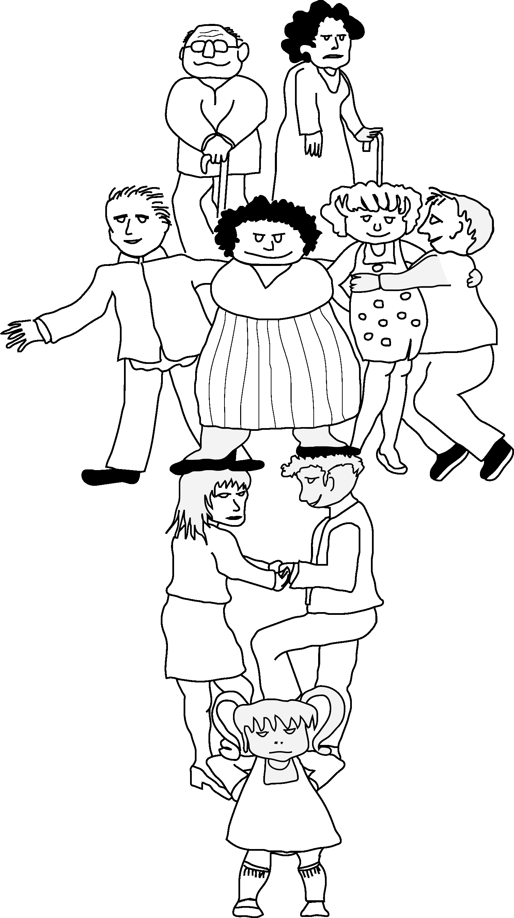
70s
2018

Slide 15
Chronic diseases
Source: Projections of global health outcomes from 2005 to 2060 using the International Futures integrated forecasting model. WHO bullettin 2011.
Notes:
Demographic, epidemiological and economic projections highlight the collapse that is closer than stakeholders realize. The need of a change is urgent: what is going to happen if effort is not taken to collect?
Despite the rising prevalence of chronic conditions which affect about 80% of people over 65 and often involve multiple morbidity, healthcare systems are still geared toward acute care; multi-morbidities are unrecognized and untreated, or not treated optimally.
Advances in research and technology, the advent of new therapies have raised the costs for healthcare. , During the last thirty years, health care expenditure has been growing much more rapidly than GDP in all OECD countries. Public spending on health and long-term care could rise from the current average level of 6-7 % of GDP to around 10% by 2050, if healthcare sector is not remodeled with policies and reforms.
Much of the current debate on the future of health is characterized by short term and siloed thinking and entrenched positions. There is a need to bridge the gaps between supply and demand, population health and individual healthcare.

Slide 16
Chronic conditions and economic burden
It has been estimated that the commonest chronic conditions are costing the EU countries more than 1 trillion Euros per year, which is expected to increase to 6 trillion Euros by the middle of the century.
In UK the cost of chronic conditions such as stroke, heart diseases, diabetes, cancer and dementia pile up to over 50% of total healthcare expenditure.
No country can afford this
1 trillion = 1.000.000.000.000.000.000

Slide 17
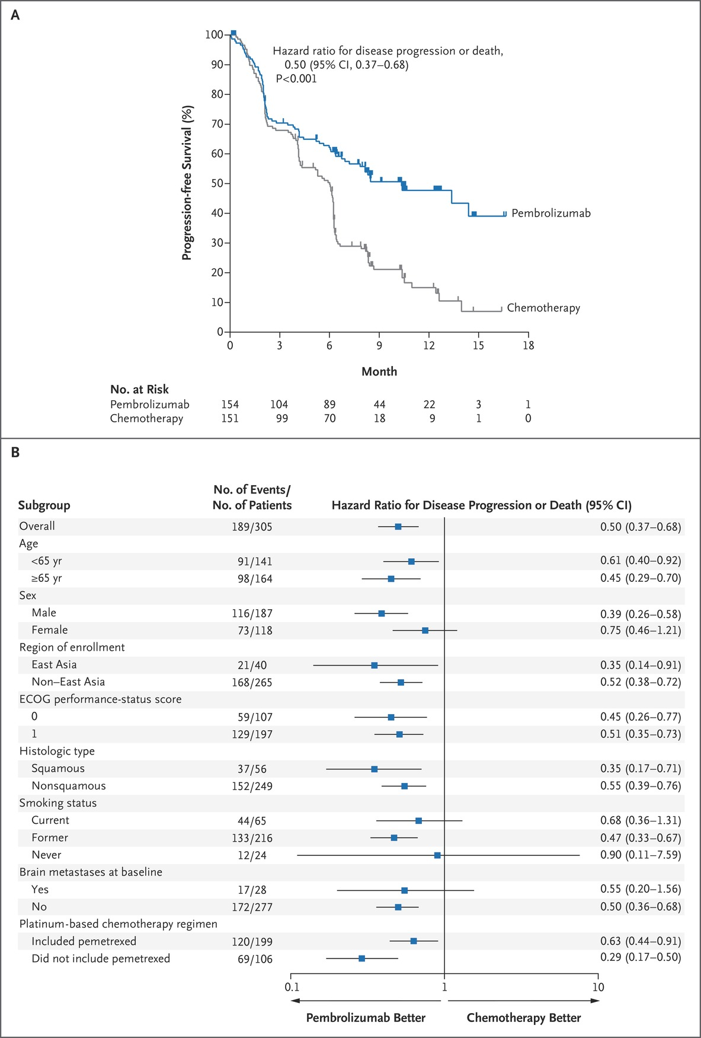
Reck M et al. N Engl J Med 2016;375:1823-1833
Notes:
Figure 1 Progression-free Survival in the Intention-to-Treat Population. Panel A shows Kaplan–Meier estimates of progression-free survival, according to treatment group. Tick marks represent data censored at the last time the patient was known to be alive and without disease progression. Panel B shows the analysis of progression-free survival in key subgroups. Progression-free survival was assessed according to Response Evaluation Criteria in Solid Tumors (RECIST), version 1.1, by means of blinded, independent, central radiologic review. The intention-to-treat population included all patients who underwent randomization. Eastern Cooperative Oncology Group (ECOG) performance-status scores range from 0 to 5, with 0 indicating no symptoms and higher scores indicating increasing disability. The subgroups for the platinum-based chemotherapy regimen are based on the regimen chosen before the patient was randomly assigned to treatment with either pembrolizumab or platinum-based chemotherapy.

Slide 19
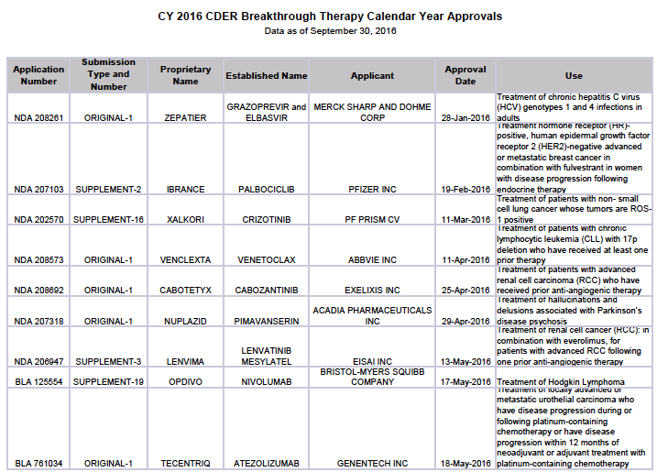
Who is going
to pay?

Slide 20
Financial constraints
Need & Demand
2012

Slide 21
Health spending
Average annual growth in health spending in real terms
Source: OECD Health Data 2013

Slide 22
United Kingdom £16.7 Billion cut since 2010
2015 the greatest rise in mortality
Record number of calls to NHS 111 Helpline
All ambulance services failing to hit targets
Increase in Waiting Lists (Even for GPs)
Record of surgeries cancelled for reasons not clinically linked
Record delays in transferring patients due to bed shortage in hospitals
Record levels of absenteeism and lack of applications to fill in the empty positions.
Health migration from North England to Scotland
Dying from hunger in English Hospitals
Dying from cold at home

Slide 24
The European social model
A system of transfers
From rich to poor
From young to old
From employed to unemployed
From healthy to ill

Slide 25
What can we do?

Slide 26
Healthcare Sustainability
Healthcare systems need to be reorganized, and sustainability framework represents a prominent option to guide new policies, plans and programs
=
Policy Maker
Investment
Aim
=
Citizen
Gaining health
Prevention
and
Early Intervention
Empowered and responsible citizens

Slide 27
Increasing inequalities

Slide 28
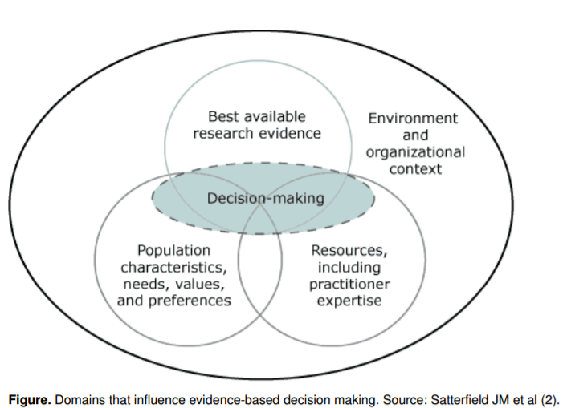
Only Evidence-based decision making
can fix it

Slide 29
"The increasing inequalities that we are storing up for our children and grandchildren are simply wrong, and are largely preventable with knowledge we already have if we chose to use it. We have no right to use resources so profligately today that we endanger the fundamental bases of health and justice for people today or tomorrow.
We need to use our voice and influence to ensure that, on our watch, we leave a legacy we can be proud of,". Pencheon D (2010), BMJ http://www.bmj.com/cgi/content/full/340/jun10_1/c3060

Slide 33
Thank you for your attention

