Slide 1
JOINT ACTION
HEALTH EQUITY EUROPE
About JAHEE…
Raffaella Bucciardini,
Istituto Superiore di Sanità, Rome, Italy
Work Package N1: Management of Action
11th European Public Health Conference (EPH),
Pre-conference- Wednesday, 28 November 2018 12:30 – 17:00

Slide 2
^{JAHEE} ^{GENERAL INFORMATION}
Project Coordinator: Istituto Superiore di Sanità, Italy
Project Full Title: Joint Action Health Equity Europe
Project Acronym: JAHEE
Starting Date: 01/06/2018
Project duration: 36 months
Project language: English
Co-Funding: 3rd European Union Health Programme (2014-2020)

Slide 3
^{JAHEE: general objective}
The general objective of JAHEE is to contribute to:
the achievement of greater equity in health outcomes across all groups of society in all participating countries and in Europe at large
the reduction of inter-country heterogeneity in tackling health inequalities
JAHEE includes a specific focus on migrants and vulnerable groups

Slide 4
^{JAHEE: specific objectives}
JAHEE aims to contribute to:
the improvement of planning and development of policies to tackle health inequalities at the European, national, regional and local level
the implementation of actions that provide the best opportunity to tackle health inequalities in each participating countries
the strengthening of a cooperative approach among participating countries
the facilitation of the transferability of good practices
4

Slide 5
JAHEE Participating Countries
25 participating Countries:
Belgium, Bosnia Erzegovina, Bulgaria, Czech Republic, Croatia, Cyprus, Denmark, Estonia, Finland, France, Germany, United Kingdom, Greece, Italy, Lithuania, Netherlands, Norway, Poland, Portugal, Romania, Serbia, Slovakia, Slovenia, Spain, Sweden.
5

Slide 6
^{JAHEE STRUCTURE}
JAHEE consists of 9 Work Packages (WPs)
4 mandatory and 5 thematic WPs
WP 1 – Management of the action
WP 2 – Dissemination
Mandatory
WP 3 – Evaluation
WP 4 – Integration in National Policies and Sustainability
WP 5 - Monitoring
WP 6 – Healthy living environments
WP 7 – Migration and health
Thematic
WP 8 – Improving access to health
and related social services for those left behind
WP 9 – Health and Equity in All Policies - Governance

Slide 7
JAHEE - Work Packages
WP | WP Name | WP Lead | Contact
WP1 | Management of the Action | Italy | Raffaella Bucciardini raffaella.bucciardini@iss.it Benedetta Mattionali benedetta.mattioli@iss.it
WP2 | Dissemination | Italy Istituto Superiore di Sanità | Paola De Castro paola.decastro@iss.it
WP3 | Evaluation | Greece 6th Health Region of Peloponnese, Ionian Islands, Epirus e Western Greece | Apostolos Vantarakis avanta@upatras.gr
WP4 | Integration in National Policies and Sustainability | Italy Region Piedmont – ASL TO3 Agenas | Giuseppe Costa giuseppe.costa@epi.piemonte.it Michele Marra michele.marra@epi.piemonte.it
WP5 | Monitoring | Sweden The Public Health Agency of Sweden | Gabriella Olsson gabriella.olsson@folkhalsomyndigheten.se AnetteRichardson anette.richardson@folkhalsomyndigheten.se
WP6 | Healthy Living Environments | Germany Federal Centre for Health Education | Christina PlantzChristina.plantz@bzga.de Yvette Shajanian-Zarneh Yvette.Shajanian-Zarneh@bzga.de
WP7 | Migration and Health | Norway The Norwegian Institute of Public Health | Bernadette N. Kumar BernadetteNirmal.Kumar@fhi.no Charlott Nordström charlott.nordstrom@nakmi.no
WP8 | Improving Access to Health and Social Services for those Left Behind | Spain Escuela Andaluza de Salud Publica | Daniel Lopez lopezacunad@gmail.com
WP9 | Health and Equity in All Policies (Governance) | Finland National Institute for Health and Welfare | Tuulia Rotko tuulia.rotko@thl.fi Katri Kilpeläinen Katri.Kilpelainen@thl.fi

Slide 8
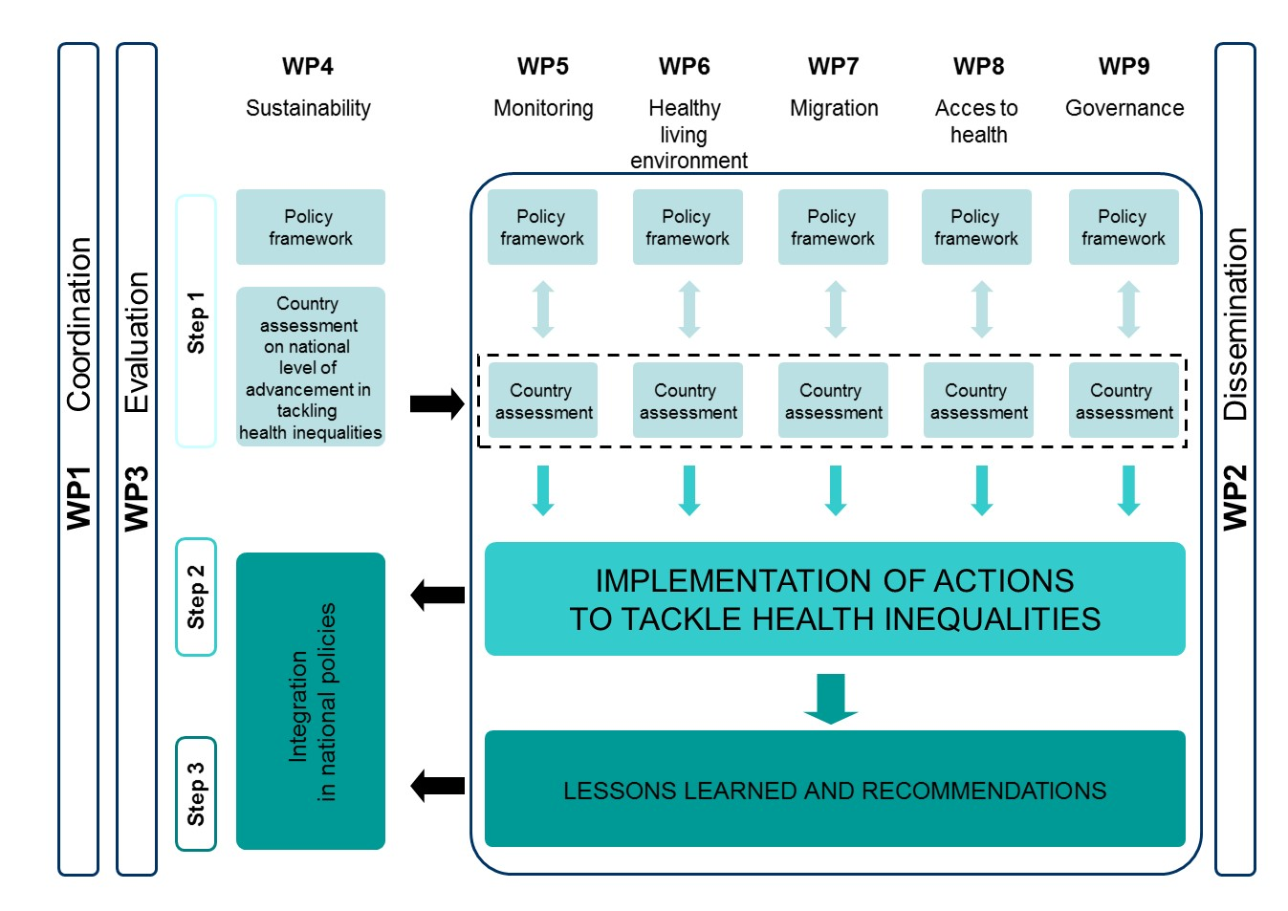
Scheme of the jahee structure

Slide 9
^{JAHEE APPROACH}
JAHEE will follow a three-step approach
1
In the first step, based on the best available knowledge, the five thematic WPs will develop a Specific Domain Policy Framework,
the WP4 will develop a General Policy Framework.
At Member State level, an individual Country profile template and
five Specific country assessments (for each thematic WP) will be elaborated.
In the second step, the participating Member States will implement a selection of actions to tackle health inequalities.
In the third step, recommendations based on the best results achieved will be produced and disseminated.
2
3

Slide 10
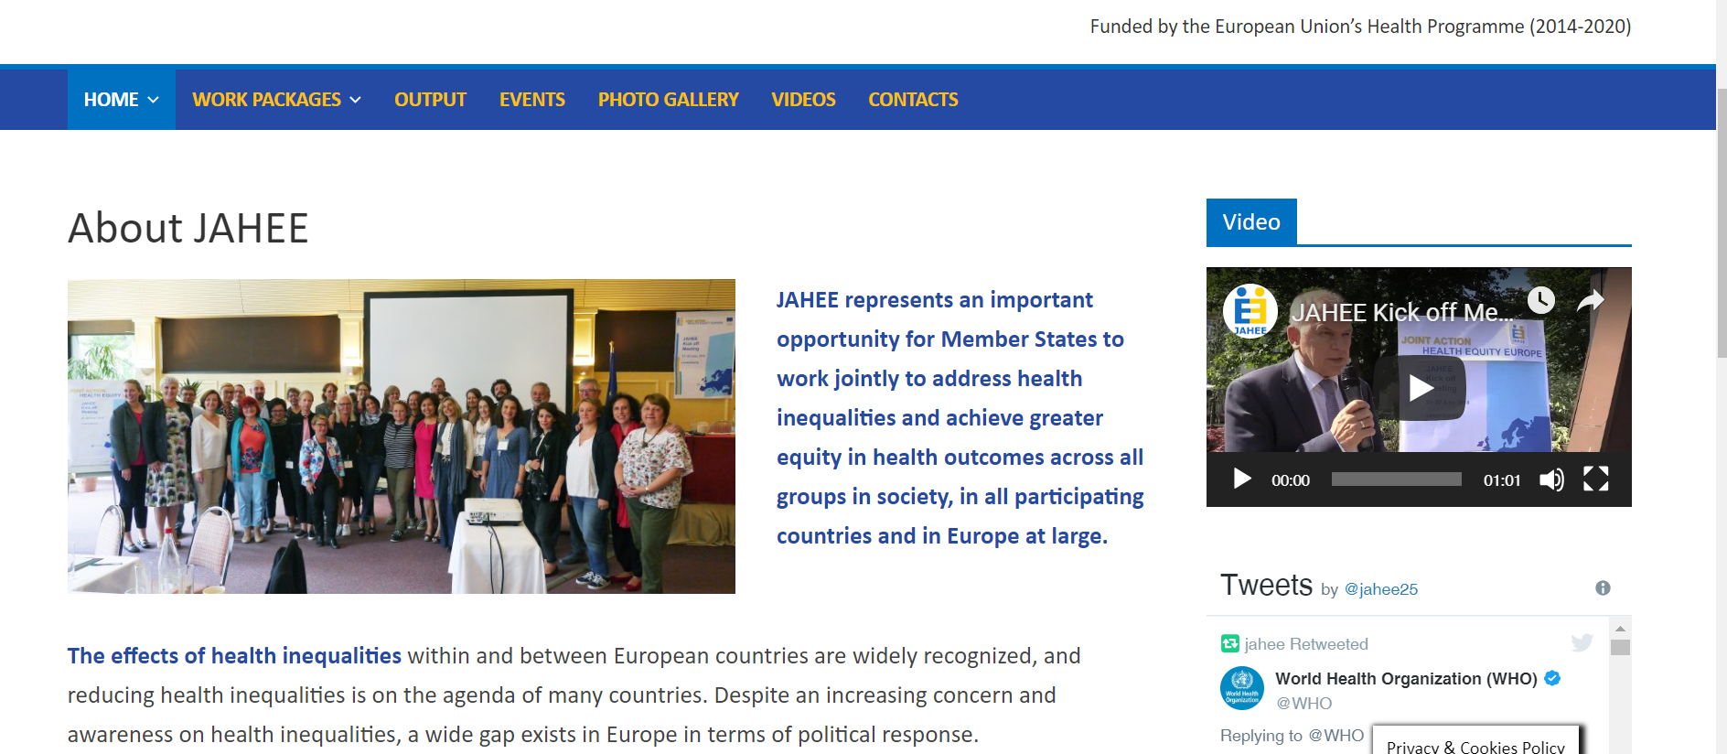
If you want to know more about JAHEE
visit the website:
https://jahee.iss.it/

Slide 11
Thank you…..
and always think positive
11

