Slide 1
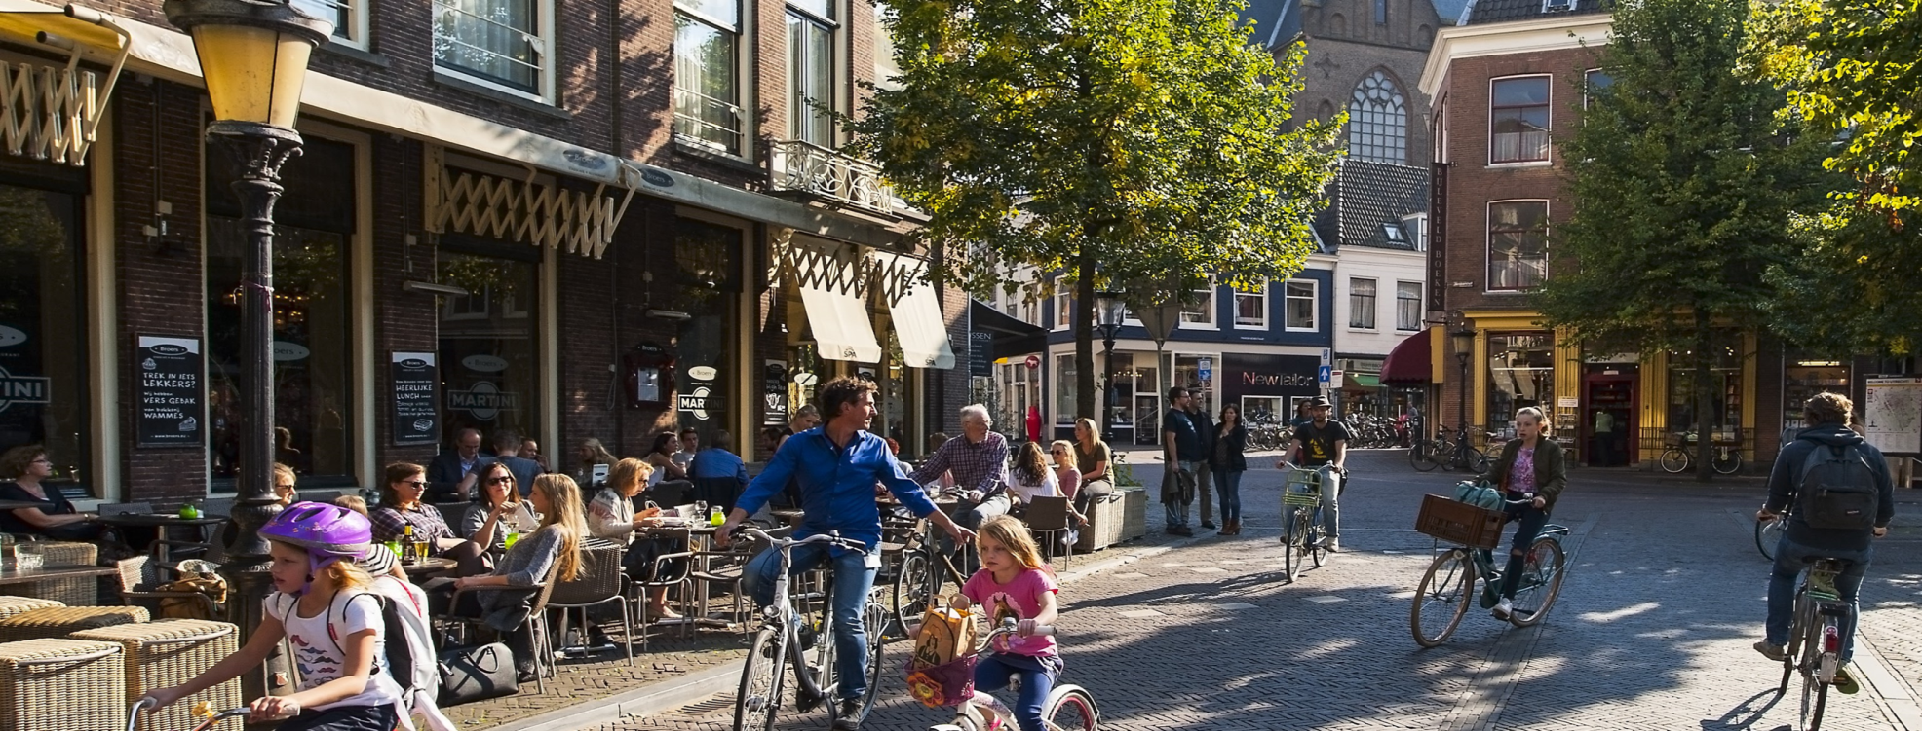

EPH Pre-conference
Health inequalities: JAHEE joint action bringing knowledge into practice
In Utrecht
Miriam Weber Ph.D.

Slide 2
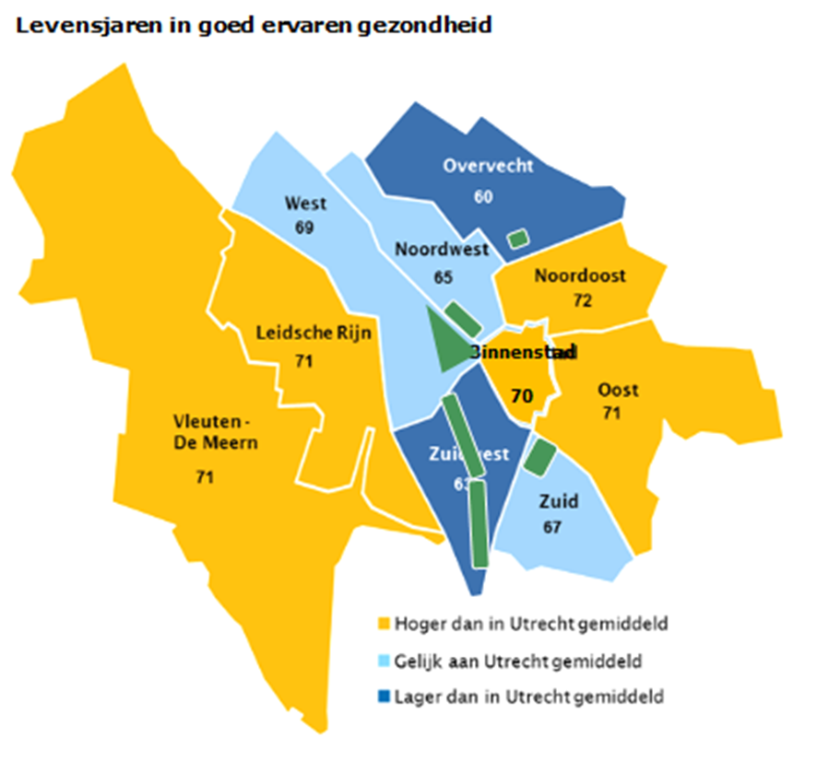
Health inequalities and densification
Life expectancy
at birth: 79,6
  Vleuten–De Meern 82,6
  Overvecht 77,8
in good health 67,3
  Noordoost 71,8
  Overvecht 59,7
without chronic diseases 44,1
  Oost 50,7
  Overvecht 34,9
Life expectancy in good health, per neighbourhood
4,8
12,1
15,8
Above Utrecht in average
Similar to Utrecht in average
Beneath Utrecht in average
Notes:
2
Addressing health inequities: differences in life expectancy
A primary school was planned adjacent to a highway. Negative advices from public health services / experts, half way project. Vice mayor not amused and subsequent order to implement health impact assessments, to put health at the heart of urban development policy.

Slide 3

Utrecht: health in all policies
Notes:
In 2012 Utrecht drafted and implemented its HiAP strategy
The public health policy document Buidling a healthy future, an invitation to the city
Characteristic are:
Health is built along three pillars, that is economic, social and spatial dimension
Health is a strength of people, a goal in itself and at the same time atool for achieving other goals, such as participation, social engagement and self development
Political decision making is built around health assessments and political leadership, for example in regional, national and international platforms such as the WHO European Healthy Cities Newtork sinds December 2016.
Public health policy is formulated as an invitation to the city, that is citizens, private sector and research institutes.

Slide 4

Ruimte voor iedereen (2018)
‘Ruimte’ = place AND space AND room for….
Overall ambitions: growing with quality
  Healthy (living) environment
    Green and water
    Attractive, accessible public space; making healthy physical activities and choices easy; safe and climate proof; et cetera
    Air quality meets WHO standards
    Neighbourhood approach
    More……..
Notes:
New local government programme (2018) focussing on healthy urban living for everybody.
As in the city we witness disparities. The risk of a growth in the city increasing this divide. The political ambition is to use this growth for addressing inequalities and inequity.
Ingegeven door:
Equal chances within the social domain (education and labour market)
Equal chances within the spatial domain, or using the growth of the city as a quality impuls. Green areas and high quality public space.
en circulair bouwen)
Versnelde aandacht voor Overvecht
Ook kansengelijkheid op ruimtelijk domein?

Slide 5
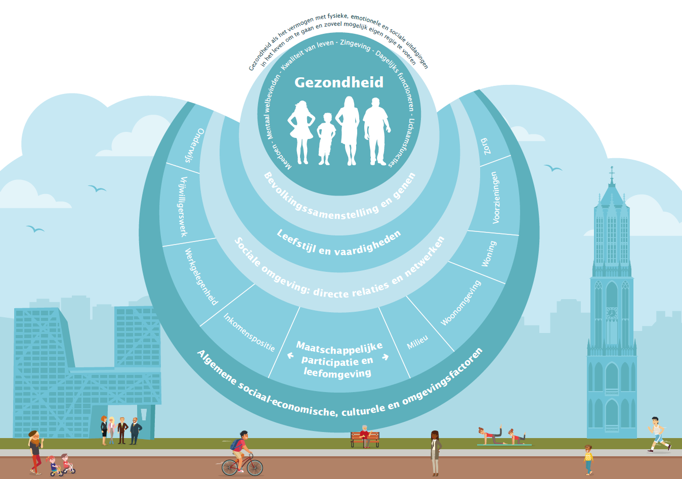
Health and resilience and equity
Care and support nearby
Healthy Urban Living for everyone
Digital city for everybody
Mobility system transition
Energy neutral city in 2030
Future work for everybody
Densification and green are balanced

Slide 6

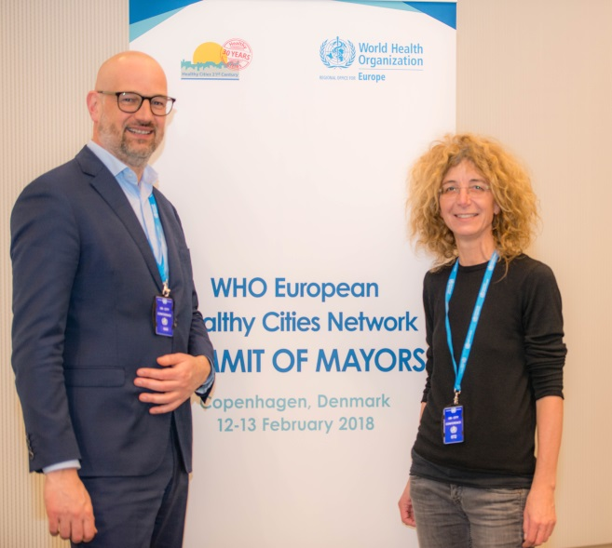
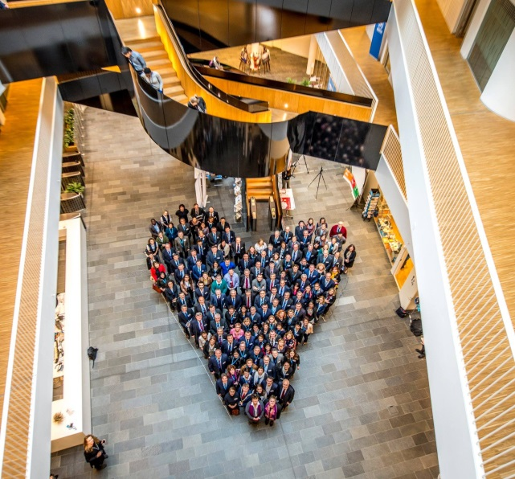
Whole of government approach
Local to global, or linking (inter)national, regional and local governments
Political leaders ánd professionals
For example: WHO European Healthy Cities Network and JAHEE
Notes:
WHO HCN Environment and Health working group
WHO Bonn instruments, tools, and norms / limits for example for air pollution and noise.
Scottish place standard for assessing places, neighborhoods with citizens, professionals and other stakeholders. And Dutch version Leefplekmonitor

Slide 7




An example: City Deals
Notes:
City Deals. City Deals zijn het middel om de doelstelling van Agenda Stad te halen: het versterken van groei, innovatie en leefbaarheid in de Nederlandse steden. In City Deals worden concrete samenwerkingsafspraken tussen steden, Rijk, andere overheden, bedrijven en maatschappelijke organisaties verankerd. Die deals moeten leiden tot innovatieve oplossingen voor maatschappelijke vraagstukken en/of maatregelen bevatten om het economisch ecosysteem van de stedelijke regio(’s) te versterken. Het streven is om ambitieuze en krachtige spelers in het stedelijk netwerk te verbinden. City Deals beogen daarmee ook nieuwe vormen van samenwerking tot stand te brengen waarmee stedelijke opgaven op een efficiënte manier worden geadresseerd. Steden bepalen zelf, in overleg met de betrokken departementen, de opgave die in iedere City Deal geadresseerd wordt.
Utrechtse City Deals: 7 deals on for example electric car sharing; healthy and sustainable food policy (links with Milan Urban Food Policy Pact); circular city; inclusive city; and health hub.

Slide 8
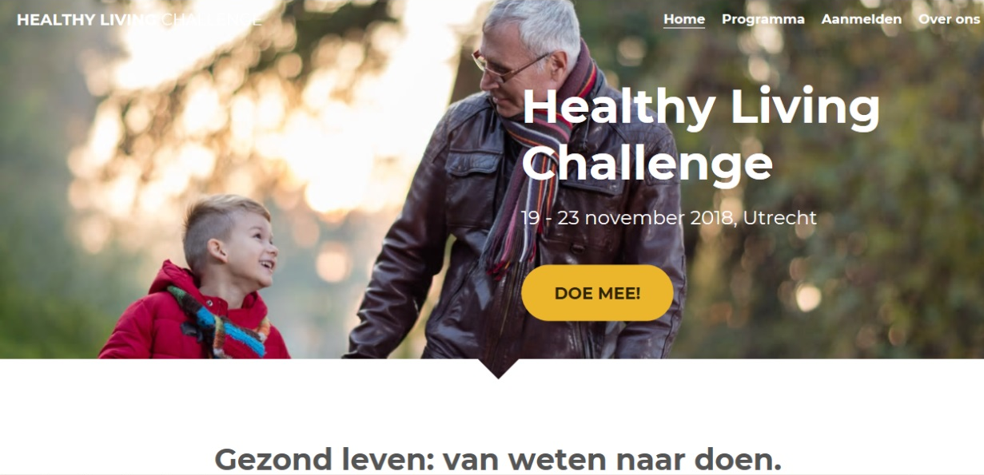

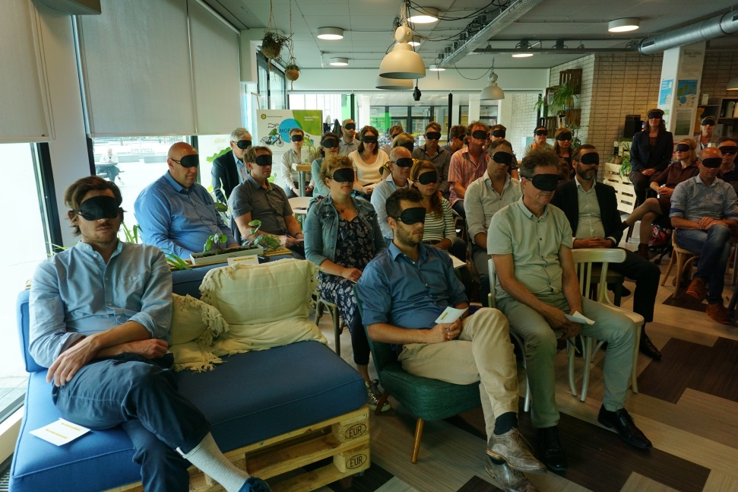
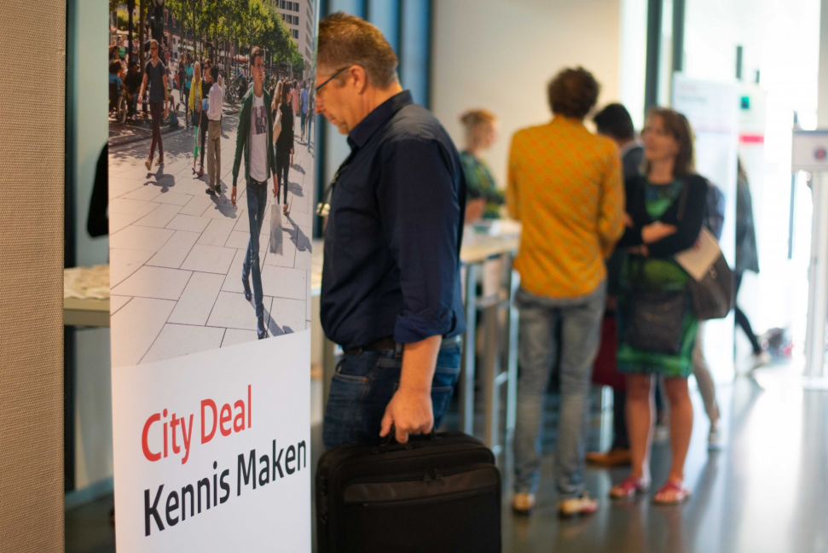
Whole of society approach
Notes:
City Deal Kennis Maken, ‘knowledge creation’ and ‘getting to know each other’. Aim is to increase the problem solving capacities, speed up innovations, in addressing societal challenges, through involvement of researchers, teachers and students. Increased use of available knowledge, and in parallel provide a so-called rich learning environment for students. As a side effect: training future professionals and committed citizens. Students being glocally active.
Linking and sharing societal challenges of sustainable, inclusive, healthy urban living with partners in the city and Utrecht region. For example the Knowledge Alliance on Healthy Urban Living, comprised of the city, province, university and university of applied sciences of Utrecht. And its research agenda.
Collaboration in research, jointly preparing research proposals for (inter)national funding, and in education, for example in so-called challenges. (challenges)
For example last week’s challenge for students from universities and vocational education working in multi-disciplinary teams. Key question was what is needed to change behaviour into healthy behaviour, healthy lifestyles. From knowing to doing. As health literacy, health knowledge is just one way. Design thinking, behaviour and concept design, pitching solutions etc.

Slide 9
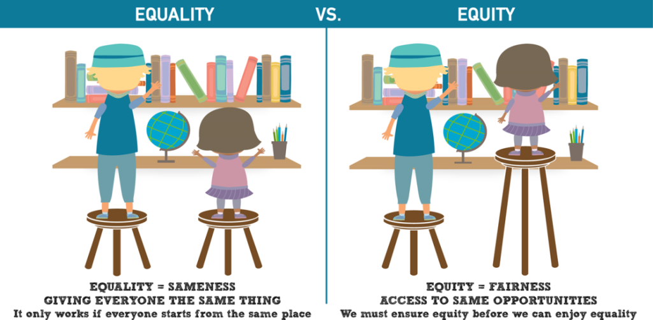
Next steps
Shifts from equality to equity, from differences to potentials
General, broad AND targeted, specific policy aiming at health benefits

Slide 10
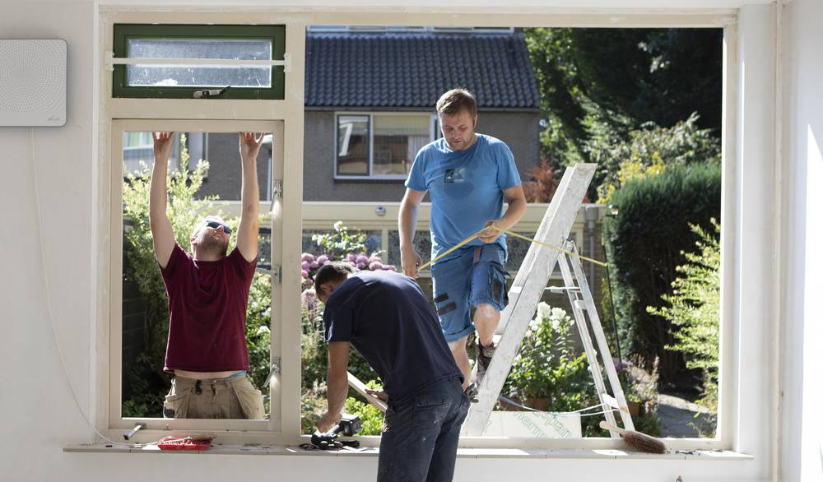
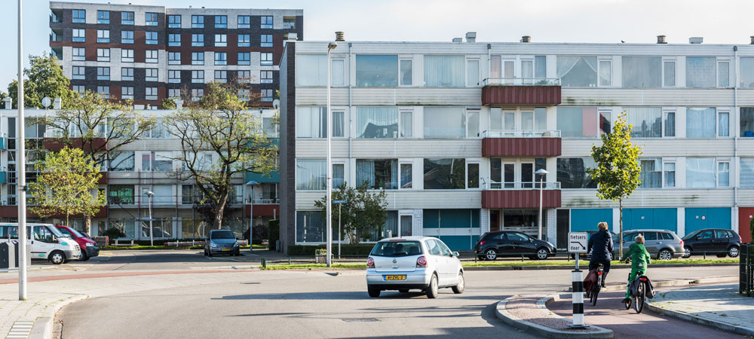
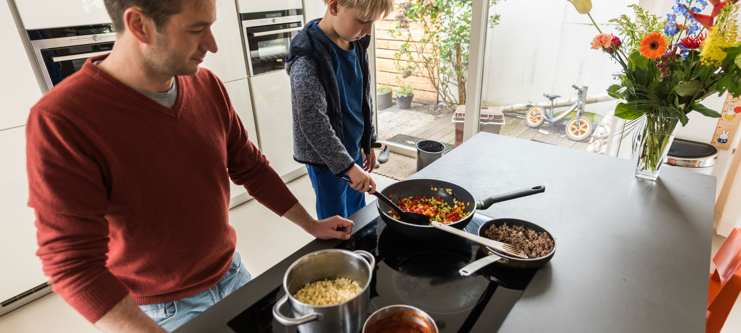
“Spatial equity”
“In order to create equity, we (sometimes) need to act un-equal”.
Linking spatial ambitions (growth of Utrecht) with societal challenges and vice versa (fairness)
Notes:
Invest in relatively healthier living environments, for individuals and / or specific population groups with lower perceived health.
For example a guiding principle could be: WHO air and noise health limits for social housing and / or at least the same air and noise levels for social housing as for other spatial developments, houses.
Onderwerp agenderen door dilemma’s inzichtelijk te maken
bijv. verdichting ~gezondheid
Acteren op de signaleringskaart
Maatwerk in wonen (zorgen dat sociale context in beeld is bij fysieke ontwikkelingen
Hoogwaardige openbare ruimte in Kanaleneiland en Overvecht
Verduurzaming in Overvecht
Beloopbaarheid (walkability)
Kennis over wat er leeft bij bewoners
toepassing gedragskennis
placemaking
van gezond ontwerp naar gezonde uitvoering
(vb. NPD-strook (Overvecht), Wonderwoods)
toepassing van WELL
(= een standaard voor gebouwde werkomgeving)
agenderen thema’s
(zoals bijv. economie en gezondheid)

Slide 11

Contact
Miriam Weber: m.weber@utrecht.nl
Notes:
11

Slide 12
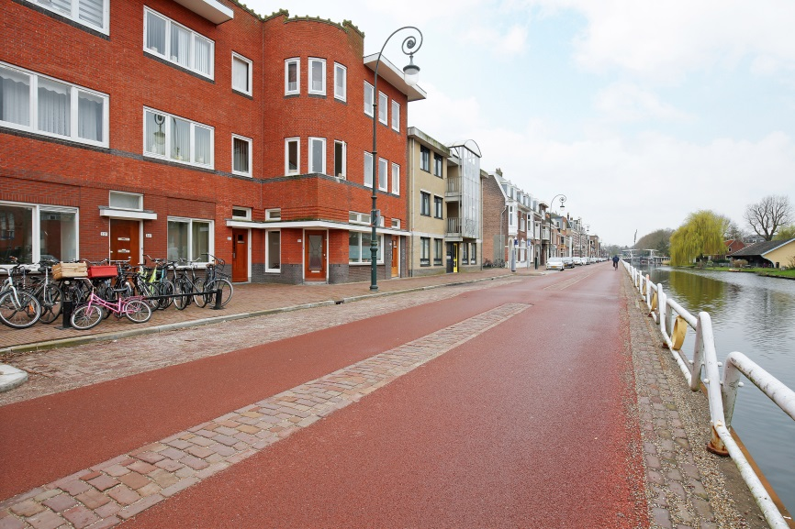
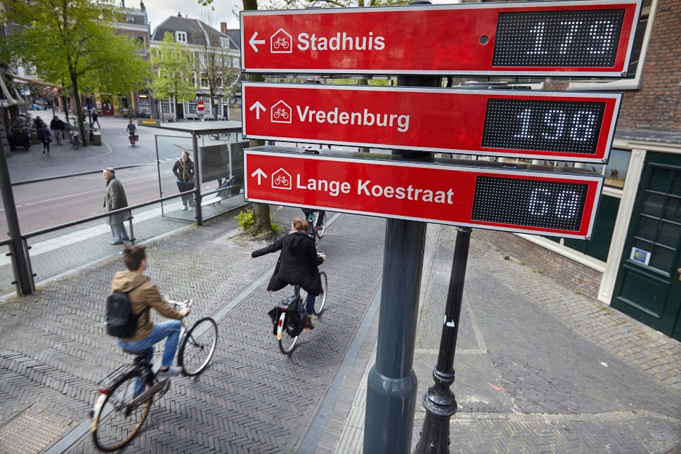
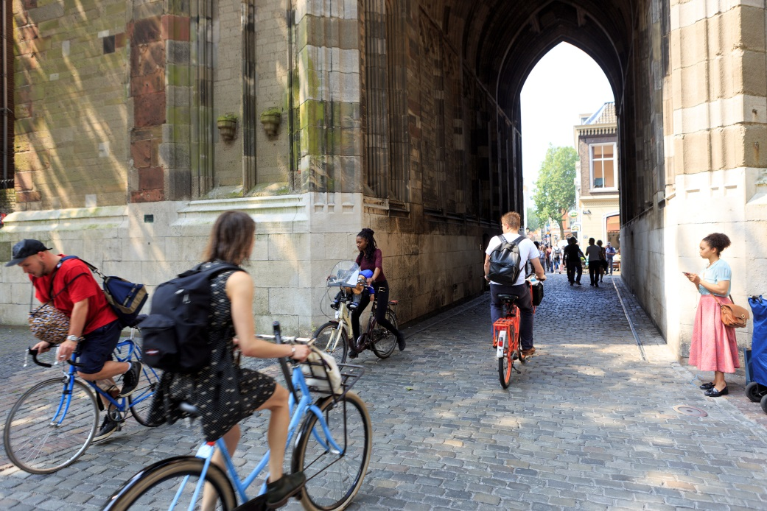
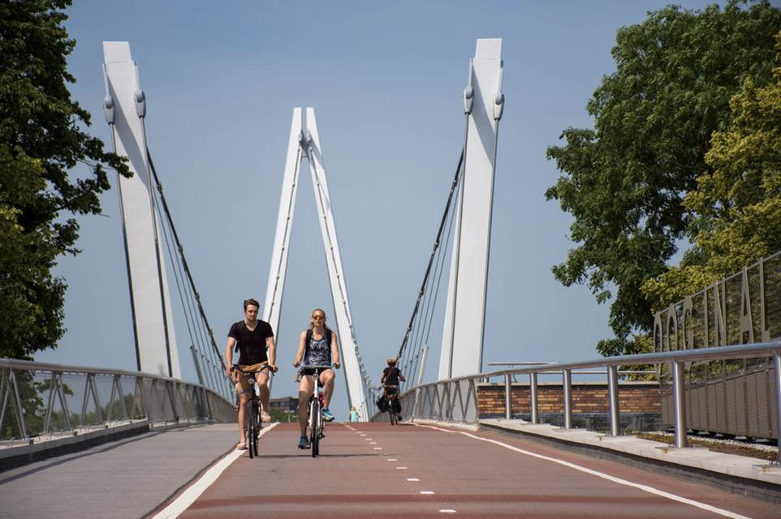

Slide 13
