Slide 1
JOINT ACTION
HEALTH EQUITY EUROPE
EUPHA pre-conference 2018
Ljubljana, Slovenia
28/11/2018
Workpackage 6 –
Healthy living environments
Christina Plantz
Federal Centre for Health Education (BZgA)
Germany
Notes:
Good afternoon dear partners and colleagues.
My name is Christina Plantz and I am very pleased to get the opportunity today to present what Work package 6 is contributing to the joint action. I work as a scientific officer in the Federal Centre for Health Education in Germany, and besides leading Work package 6, we participate in all the other work packages but one.
→ Next slide

Slide 2
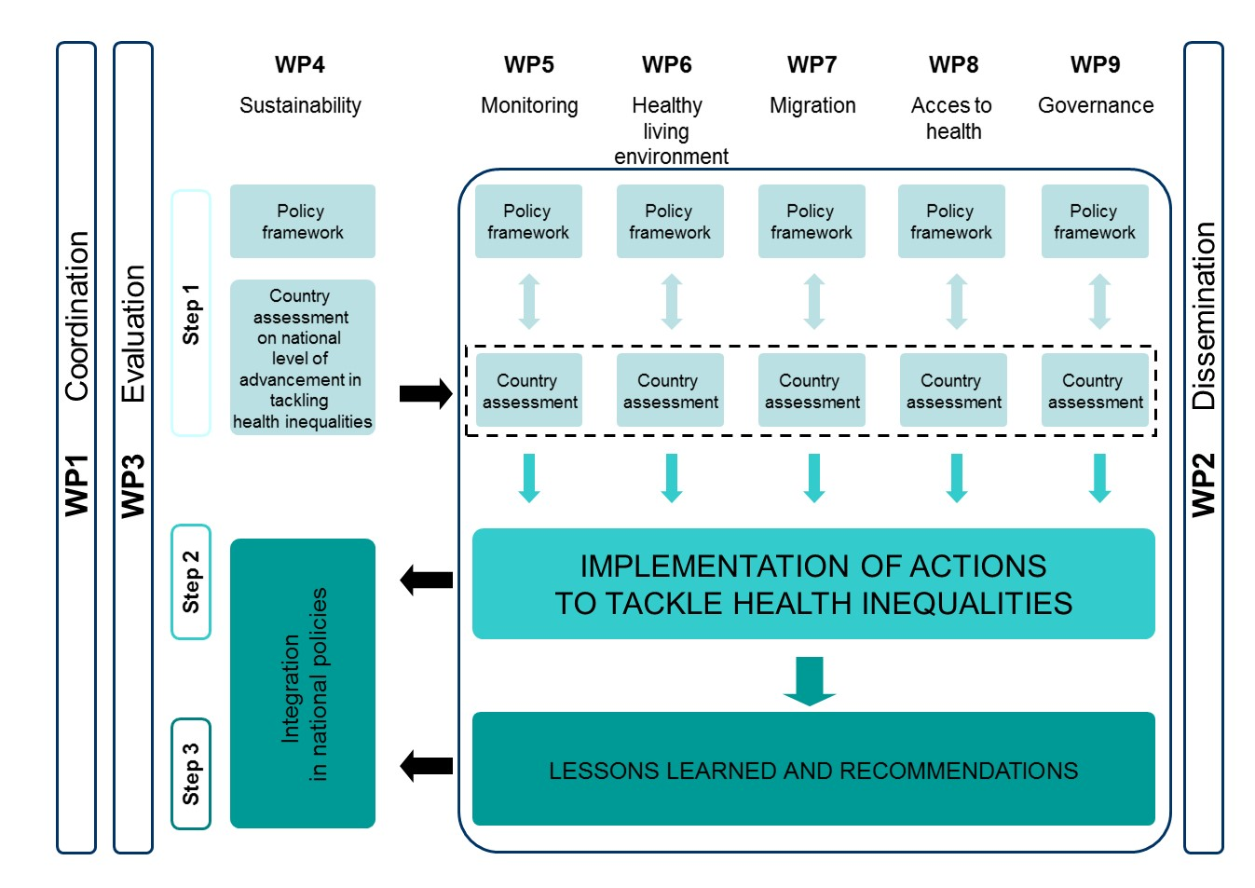
JAHEE structure
Notes:
So, where are we located in the project structure? As you can see, Work package 6 Healthy living environments belongs to the thematic work packages of the policy domains that are seen to be relevant to reduce health inequalities. We all have the same 3-step-process:
First the development of a Policy Framework for Action, the assessment of the country context and situation and the identification of good practices.
Second, and this will take most of the time, the implementation of actions. The actions are based on the identified good practices to create healthy living environments from the participating countries.
And third step will be to collect the lessons learnt during the implementations and to generate policy recommendations.
→ Next slide

Slide 3

13 countries
17 Institutions
1 – Italy
ISS
ASLTO3
6 – Cyprus
MoH CY
7 – Czech Repulic
NIPH
12 – Germany
BZgA
13 – Greece
DYPEDE
15 – Netherlands
minVWS
17 – Poland
SUM
18 – Portugal
MS
19 – Romania
SNSPMPDSB
INSMC
20 – Serbia
IPHS
IPHN
22 – Slovenia
NIJZ
23 – Spain
FISABIO
DPTSALUD,GV
24 – Sweden
FoHM
Notes:
I want to show you quickly who are the participating partners and countries in Work package 6.
As you can see, there are 13 countries from all parts of Europe, and 17 institutions and authorities, from the national, regional and local level.
→ Next slide

Slide 4
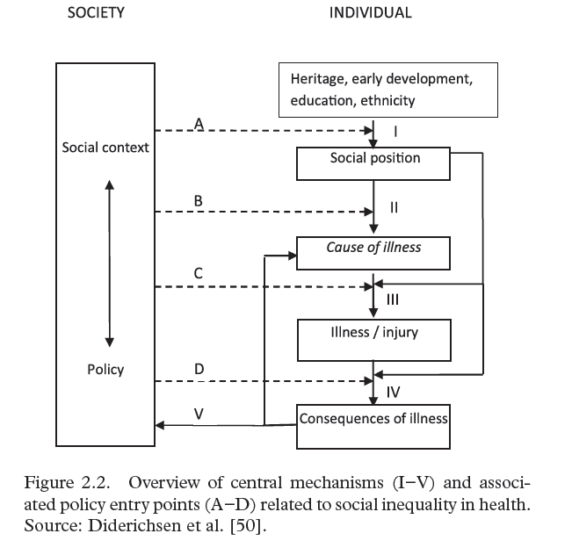
^{Mechanisms} for HI
Differential exposure
Differential vulnerability
Diderichsen (2012)
Notes:
So now I‘d like to show you where we start from in WP6, why healthy living environments is a relevant topic for the joint action.
This model of Diderichsen et al. from 2012 is used as a theoretical basis. It shows very well the determinants of health inequality, their mechanisms and entry points for action.
The main mechanisms for health inequality, where the context and the conditions in which people live, plays an important role, is what you can see here in roman numbers II and III.
→ Click
II represents a mechanism we call differential exposure and describes the fact that the degree of exposure to a wide range of risk factors but also resilience factors depends on the social position.
Mechanism III describes a differential vulnerability of people. Lower social groups are frequently exposed to several different physical, social and behavioural risk factors for disease, and the effect is likely to be stronger. That‘s why they are called more vulnerable.
And, of course, there are also life-course effects when exposure starts in early years and accumulates over time.

Slide 5

Examples for evidence for unhealthy and unequal living environments:
Residential segregation
Social cohesion
Supportive social relationships
Environmental health risks (as air, soil, water)
Physical activity
Accidents and injury
Accessibility of healthy foods
Diderichsen (2012)
Notes:
So let‘s see what we know about unhealthy and unequal living environments.
Click
Segregation in the housing market contributes to differential exposure to environmental risk factors.
Deprived areas with large in-and-out-migration have a lower degree of social cohesion and people have fewer supportive social relationships.
There is good evidence for a strong association between the physical environment and physical activity. And there is good evidence that the geographic accessibility of healthy foods is associated with healthy nutrition. The physical environment also influences the occurrence of accidents and injuries.
And these are also the points of entry for action.
What do we know about effective interventions?
→ Next slide

Slide 6
Examples for recommended action for healthy living environments:
Promoting health:
Reducing risk factors:
Traffic safety measures
Walkability concept
Capacity Building
Green environments concept
Reducing particle pollution
Health y settings
Neighbourhood frameworks
Improving housing quality
Urban planning and development
Diderichsen (2012)
Notes:
What do we know about effective action against these conditions?
There are 2 main strategies: Promoting health and strengthen resilience factors, and second reducing risk factors.
→click
The effects of reducing particle pollution and realizing traffic safety measures are clear.
Click
What can be found for example, is that concepts like walkability or green environments have positive effects on physical activity. Neighbourhood frameworks including urban gardening contribute to a better degree of social cohesion. Health policies in settings, like schools, youth clubs, kindergardens, nursing homes, especially in deprived areas, contribute to make the healthier choice the easier choice.
→ Click
But there is one important to do that frames all these activities. There is a need for an overall municipal strategy and urban planning and development. Inter-sectoral cooperation and the promotion of capacity building play a central role in the creation of healthy living environments. Examples of urban development projects that promote the health of their residents is Age-Friendly Cities, child-friendly Cities or the design of a "Women-Work-City" housing complex to better support the daily living conditions of women. Health inequalities are reduced through city administration and planning, including investment in active traffic, environmental and regulatory controls.

Slide 7
Healthy living environments – Setting the frame (1)
Determinants of health
Municipal services for the public
& health equity
Health Promotion: Influencing the determinants
Equity lens
Economic,
cultural, social, environmental, services
Figure by author based on Walter/Volkenand 2017
Notes:
So, the focus of Work package 6 will be on the municipal level. As you can see here in the figure, many municipal services and activities influence the determinants of health.
A municipality as umbrella setting with the aim to reduce health inequalities has to apply an equity lens in its urban planning and development measures, and in its health promotion activities.
The local conditions and needs have to be analyzed. A local health and equity in all policies approach needs to be pursued. Sometimes it is necessary to focus on specific vulnerable population groups. In any case the determinants of health inequalities have to be addressed.
The Policy Framework for Action that we are developing at the moment is supposed to describe what should be done to create these healthy living environments in this understanding.
One of the key words here are participatory governance, partnerships and networking, integrated approaches and strategies.

Slide 8
^{Objectives} WP6
Identify strategies, policies and promising models of good practice to better understand assets and impacts of living environments on healthy life styles, risk & resilience factors
Develop implementation guidelines, e.g. for healthy urban planning
Develop an advocacy guidance for decision makers and stakeholders
Notes:
So this is our basis for Work package 6 and these are our objectives according to the theoretical framework I’ve just presented.
Click
Click
click
And now I am very pleased to hand over to my colleague Miriam Weber, who will animate this theoretical framework for Work package 6 with a wonderful example from the Netherlands.
Thank you very much for your attention!

Slide 9
Healthy living environments – Setting the frame
Municipality
(Deprived/ high risk) Quarter / village / area
Kindergardens
Schools
Nursing homes
Other settings
Children
Vulnerable groups
Elderly
Figure by author based on Walter/Volkenand 2017
Notes:
As people move between different settings, transitions between the setting (school and family) and cross-setting activities have to be pursued. This requires coordinated approaches in which isolated measures in single settings relevant for a person are merged into an integrated “ living environment“-strategy. Municipalities can be regarded as umbrella settings including different smaller settings which sum up to a holistic living environment.
A municipality as umbrella setting with the aim to reduce health inequalities has to apply an equity lens in its urban planning and development measures, and in its health promotion activities. A local health and equity in all policies approach needs to be pursued. Sometimes it is necessary to focus on specific vulnerable population groups. In any case the determinants of health inequalities have to be addressed.
The Policy Framework for Action that we are developing at the moment is supposed to describe what should be done to create healthy living environments, so to say the ideal and the vision.
That’s why we decided to describe an ideal model of implementation for Workpackage 6. It combines a process with quality criteria.
→ Next slide

Slide 10
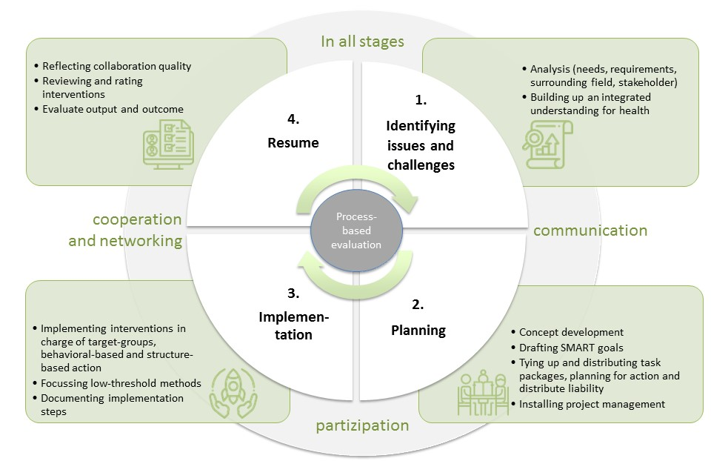
Healthy living environments – Ideal implementation model
Notes:
Our idea of the ideal process to create healthy living environments is the Public Health Action Cycle that you all might know very well.
You can see the 4 phases, and then the cycle restarts. We combined the cycle with 15 good practice criteria for interventions that we generated from the literature.
For all 4 phases, municipal health promotion can only succeed in joint and cross-sector efforts. Existing local partnerships and cooperation networks should be integrated. Also, the goal of empowerment and participation must be pursued consistently though all phases.
In the country assessments that we are planning to conduct in the beginning of next year, good practice examples will be identified and described according to this model.
As you can see, we have a strong connection to Work package 5 Monitoring, when it ccomes to local needs analysis.
And, of course, a local Health and equity in all policies approach links us closely to Work package 9. You will hear more about that in a few minutes.
Now, I am very pleased to hand over to my colleague Miriam Weber, who will animate this theoretical framework for Work package 6 with a wonderful example from the Netherlands.
Thank you very much for your attention!

Slide 11
JOINT ACTION
HEALTH EQUITY EUROPE
EUPHA pre-conference 2018
Ljubljana, Slovenia
28/11/2018
THANK YOU!
Christina Plantz
Federal Centre for Health Education (BZgA)
Germany
Notes:
Good afternoon dear partners and colleagues.
My name is Christina Plantz and I am very pleased to get the chance today to present the work package I am coordinating. I work as a scientific officer in the Federal Centre for Health Education in Germany, and besides leading Work package 6, we participate in all other work packages but one.
→ Next slide

